Slide 1
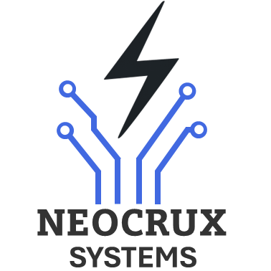
INTRODUCTION TO ARM ARCHITECTURE

Slide 2

Definition of ARM Architecture
ARM (Advanced RISC Machine): A family of Reduced Instruction Set Computer (RISC) architectures
Designed for efficient, low-power processing in embedded systems
Widely used in microcontrollers, smartphones, tablets, and IoT devices
Enables customization without altering core hardware design

Slide 3
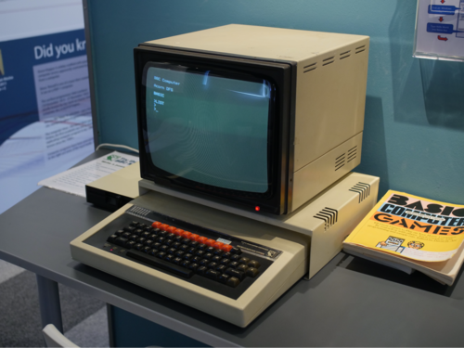

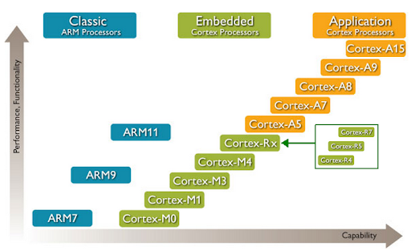
Historical Background
1983: Acorn Computers develops ARM1 as a co-processor for BBC Micro
1990: ARM Ltd. founded, focusing on IP licensing model
1998: ARM7TDMI powers early mobile phones (e.g., Nokia 6110)
2000s: ARM Cortex series introduced (Cortex-A, Cortex-M, Cortex-R)
2020s: Expansion into servers and AI with ARMv9 architecture

Slide 4
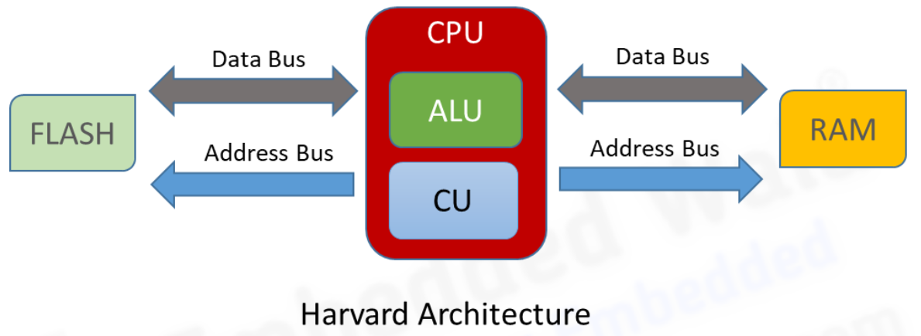
ARM Architecture Overview
RISC-Based Design
Harvard Architecture
Known as RISC (Reduced Instruction Set Computer)
Simplified instruction set for faster execution
Separate memory buses for instructions and data
Fixed 32-bit instruction size (ARM) or 16/32-bit (Thumb mode)
Enables simultaneous access, reducing bottlenecks
Single-cycle instruction execution in many cases

Slide 5
ARM Architecture Overview
Thumb Instruction Set
ARMv7 and ARMv8
ARMv7: Cortex-M (microcontrollers), Cortex-A (application processors)
Compressed 16-bit instructions for higher code density
Balances performance and memory usage
ARMv8: 64-bit support, enhanced security (e.g., TrustZone)

Slide 6
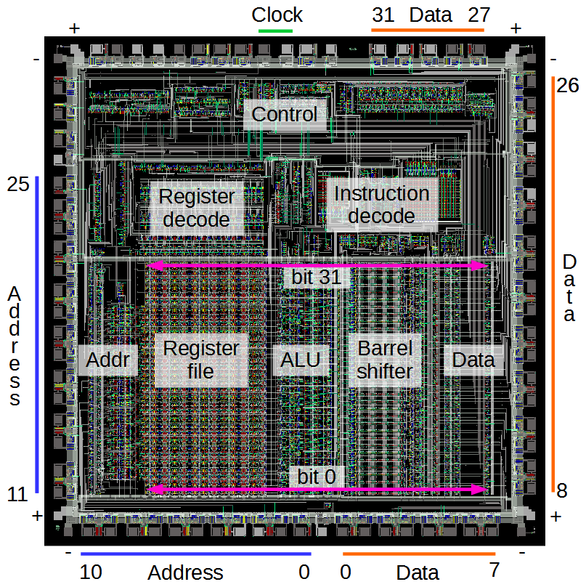
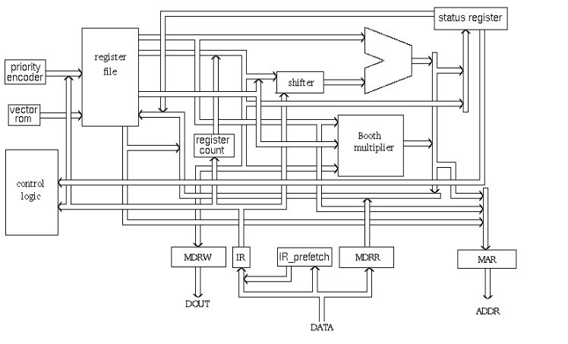
Architecture overview
ARM Block Diagram
ARM V1

Slide 7
Key Features and Capabilities
Low-Power Modes: Deep sleep, standby, and dynamic power scaling
Scalability: From 8-bit-like Cortex-M0 to 64-bit Cortex-A processors
Peripherals:
Digital and analog I/O, timers, PWM, watchdogs
Communication interfaces: UART, I2C, SPI, CAN, USB, Ethernet
Built-in ADC, DAC for sensor integration

Slide 8
Key Features and Capabilities
Security Features: TrustZone, cryptographic extensions
Floating-Point Unit (FPU): Optional in Cortex-M4/M7 for signal processing
Interrupt Handling: Nested Vectored Interrupt Controller (NVIC)

Slide 9
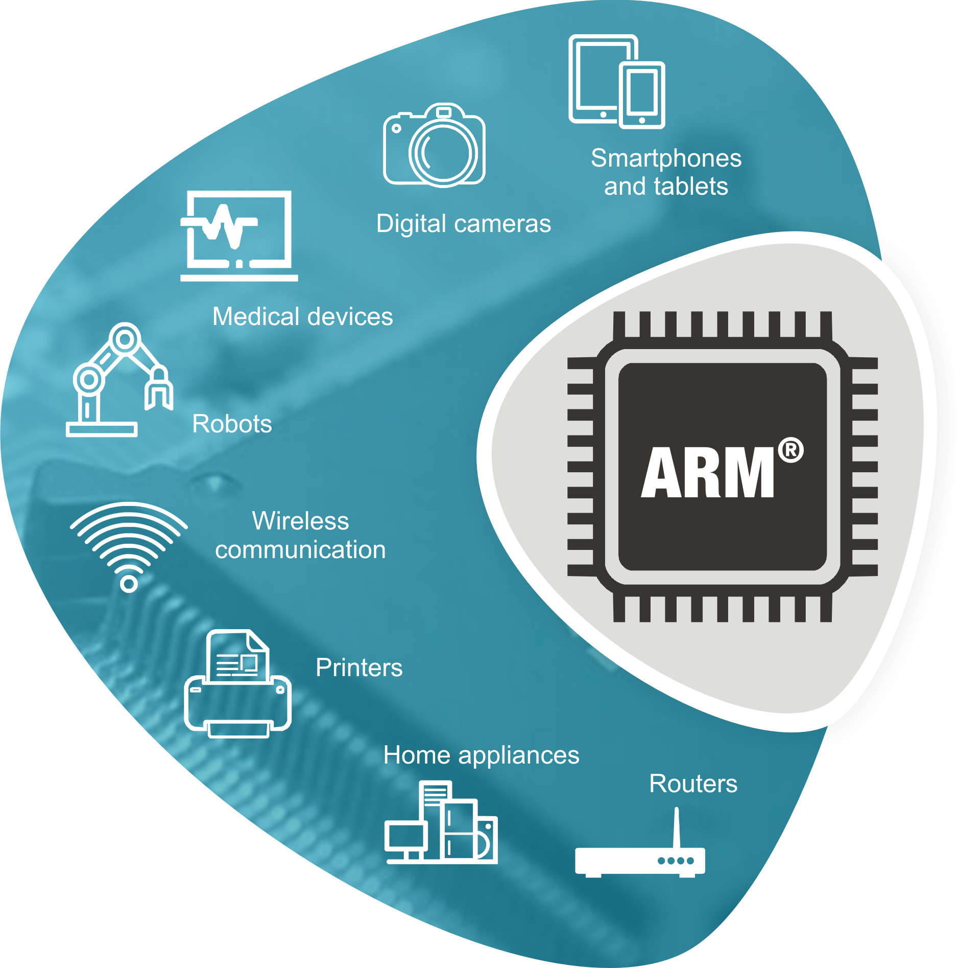
Applications of ARM Architecture
Consumer Electronics
IoT Devices
Automotive
Industrial Automation
Medical Devices

Slide 10
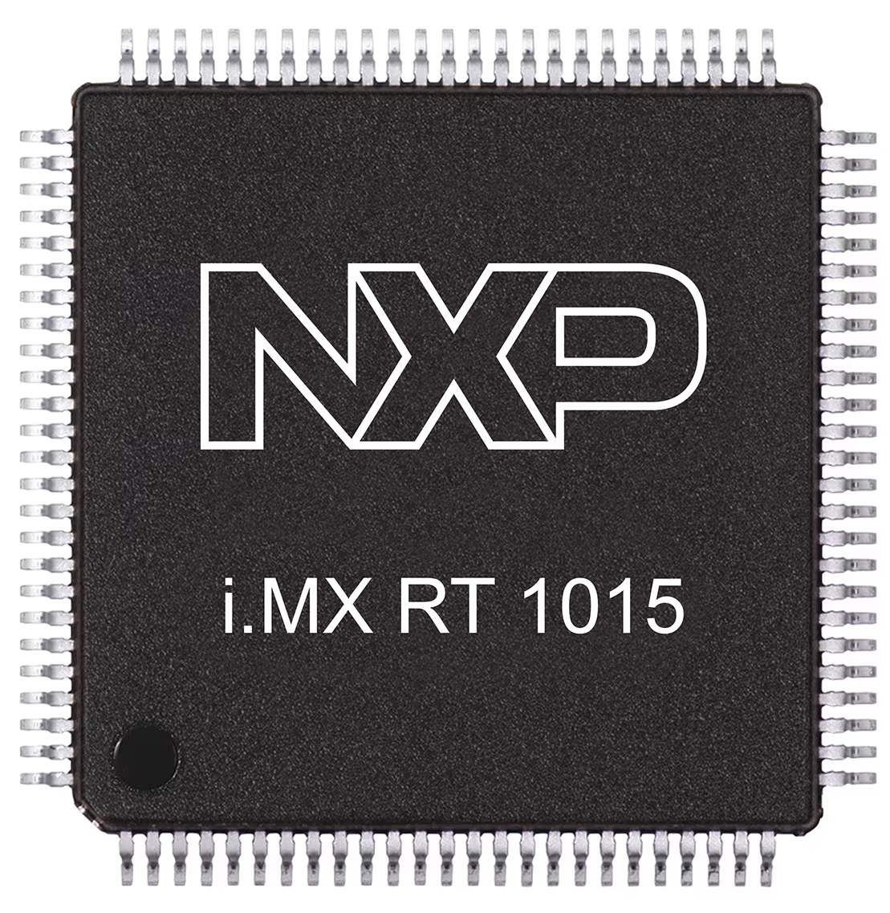
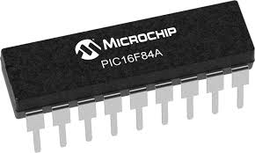
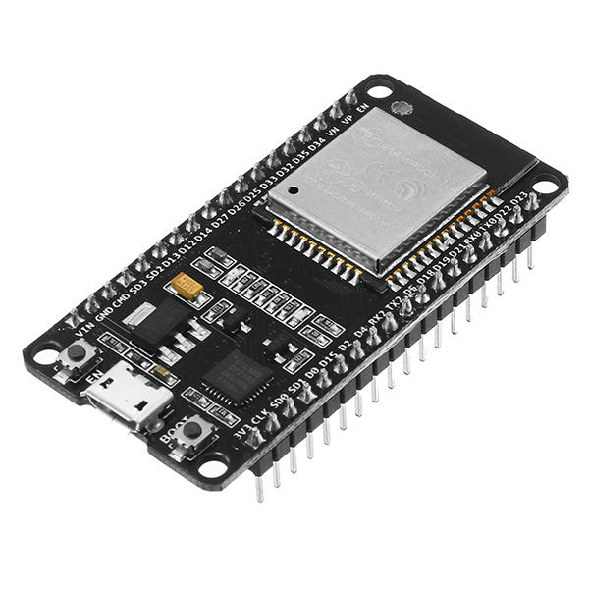
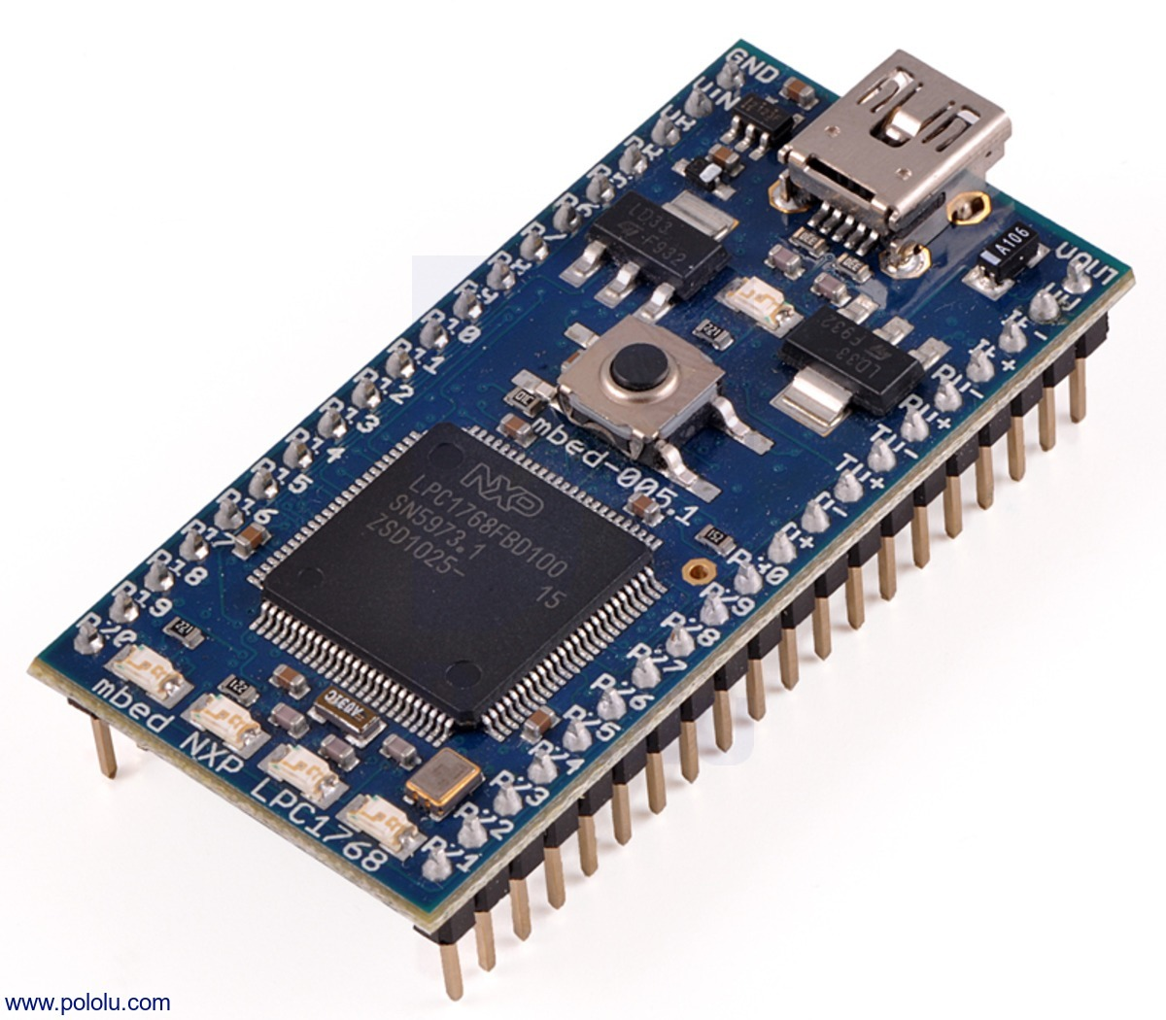
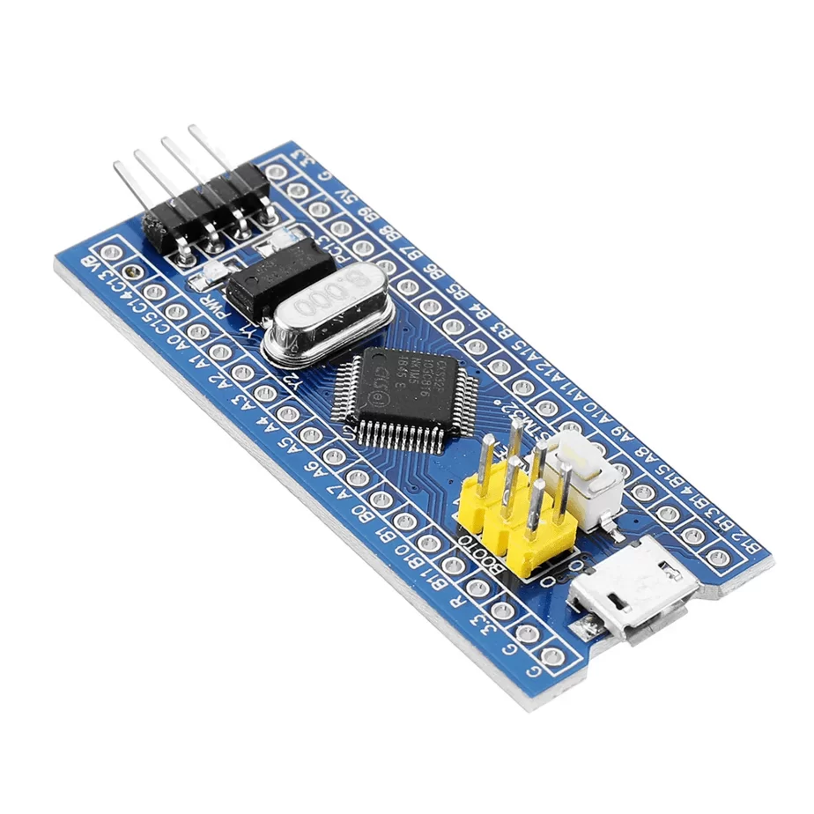
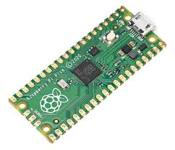
Popular ARM-Based Microcontroller Platforms
STM32 (STMicroelectronics): Cortex-M0/M3/M4/M7, wide range of peripherals
NXP i.MX RT (Cortex-M7): High-performance crossover MCUs for real-time tasks
ESP32 (Espressif): Dual-core Cortex-M, Wi-Fi/Bluetooth for IoT
Raspberry Pi Pico: Dual-core Cortex-M0+
Arduino Portenta H7: Cortex-M7/M4 dual-core

Slide 11
Challenges and Considerations
Complexity in Design
Power Optimization
Toolchain Costs
Real-Time Constraints

